Slide 1

COMANDOS PARA JOGAR

Slide 2



0
0

Slide 3
0
1
0
1

Slide 4
0
1
2
0
1
2

Slide 5
0
1
2
3
0
1
2
3

Slide 6
0
1
2
3
0
1
2
3

Slide 7
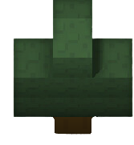

0
1
2
3
0
1
2
3
3

Slide 8

0
0
1
1
2
2
3
3
0
1
2
3
0
1
2
3

Slide 9

0
1
2
3
0
1
2
3

Slide 10


0
1
2
3
0
1
2
3

Slide 11

0
0
1
2
3

Slide 12
0
0
1
2
3

Slide 13

0
1
2
3

Slide 14

0
1
2
3

Slide 15

0
1
2
3

Slide 16
0
1
2
3

Slide 17
0
1
2
3

Slide 18
0
1
2
3
4

Slide 19
0
1
2
3
4

